Slide 1
ROUNDING UP CMP103
GOOGLE APPS
ATTENDANCE CARDS
CISCO ITE
1ST SEMESTER EXAMS
MAKE UP ASSESSMENT

Slide 2
GOOGLE
Google has come a long way since its inception in 1998 to become the world’s largest and most-used search engine site. Google has transformed the way we used to study and played a major role in imparting education and knowledge accessible and comfortable for all

Slide 3
GOOGLE: OPEN TECHNOLOGY
Google strongly thinks that open technology is important to boost the education system and the open technology can revolutionize education.

Slide 4
GOOGLE: ROLE IN EDUCATION
It empowers students and levels the playing field for them: Google empowers students irrespective of their age, socioeconomic status, nationality, gender, religion, ethnicity, and other such factors.

Slide 5
GOOGLE: ROLE IN EDUCATION
Its free search-engine site and low cost apps and devices allow everyone to afford the service

Slide 6
GOOGLE: ROLE IN EDUCATION
Its apps and services foster high degree of collaboration and teamwork

Slide 7
GOOGLE: ROLE IN EDUCATION
Its apps enhance efficiency, productivity, and effectiveness of the educators and students: The Google apps and products are superfast and supported by the best talent pool in the world

Slide 8


Google Drive

Slide 9
Objectives
Google Drive
Understand “The Cloud” and how it works
Create a Google Drive account
Know how to create documents, organize My Drive, and download Drive documents as Office files

Slide 10
The Cloud/Google Drive
Google Drive
Cloud Computing: Saving information to a server on the internet so you can access it anywhere with an internet connection
Create Office documents – Word, Excel, PowerPoint
Create forms for surveys, quizzes, data collection
Collaborate with others anywhere at anytime
Share documents for others to leave comments on, view, and edit.

Slide 11
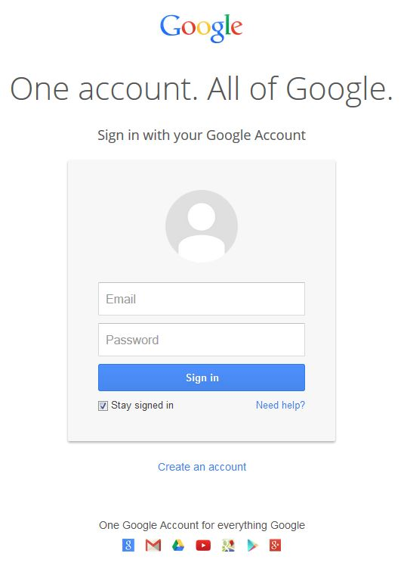
Logging In
Google Drive
Log In or Create Account
Requires Google account
Do not need Gmail – can use any email address to create an account
Notes:
Challenge: Create your own Google Drive account

Slide 12
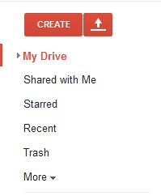
Navigation Bar
Google Drive
Red Buttons: Create and Upload
My Drive: Create folders and move items around to quickly locate the files you need
Shared With Me: Files you did not create but have permission to view and/or edit
Starred: Shortcut items
Recent: The files you have accessed most recently
Notes:
Challenge: Create a folder in My Drive

Slide 13
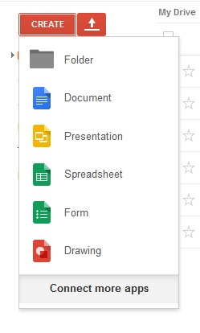
Create a Document
Google Drive
Document: Word
Presentation: PowerPoint
Spreadsheet: Excel
Form: Survey
Drawing: Paint
Save automatically

Slide 14
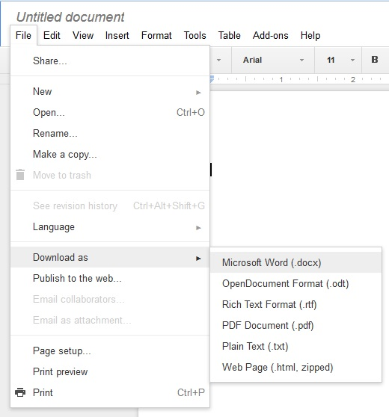

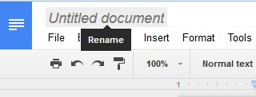
Within the Document
Google Drive
Renaming
Sharing
Downloading
Formatting
Notes:
Show on live document how to change name, share (+ share options), download, and describe formatting toolbar.
Challenge: Create a new document and give it a name. Bonus: move the file into the folder created in My Drive

Slide 15

Google Drive
Questions?

Slide 16
Challenges
Google Drive
Create Google Account
Create a folder in My Drive
Create and rename a new document
Move document into the new folder in My Drive

